Slide 1



Shield Insurance
01

Slide 2
Shield Insurance
Shield Insurance
Shield Insurance Company is a leading provider of reliable policies and comprehensive coverage, prioritizing customer satisfaction and offering tailored solutions through advanced data analytics.
Shield Insurance established itself as a trustable company in the insurance business
02

Slide 3

Shield Insurance
1
Chennai
2
Hyderabad
Operating Cities
3
Delhi
4
Mumbai
5
Indore
03

Slide 4
Shield Insurance
Months
November
2022
2023
February
December
2022
2023
March
January
2023
2023
April
04

Slide 5
Shield Insurance
1
Offline Agent
Sales Mode
2
Offline Direct
3
Online App
4
Online Website
05

Slide 6



Shield Insurance
Tracking Revenue and Customer
Daily Revenue and customer growth rate
Key Action items
Sales Mode Analysis
Service 03
Trends for revenue and customer
Age Group Analysis
06

Slide 7
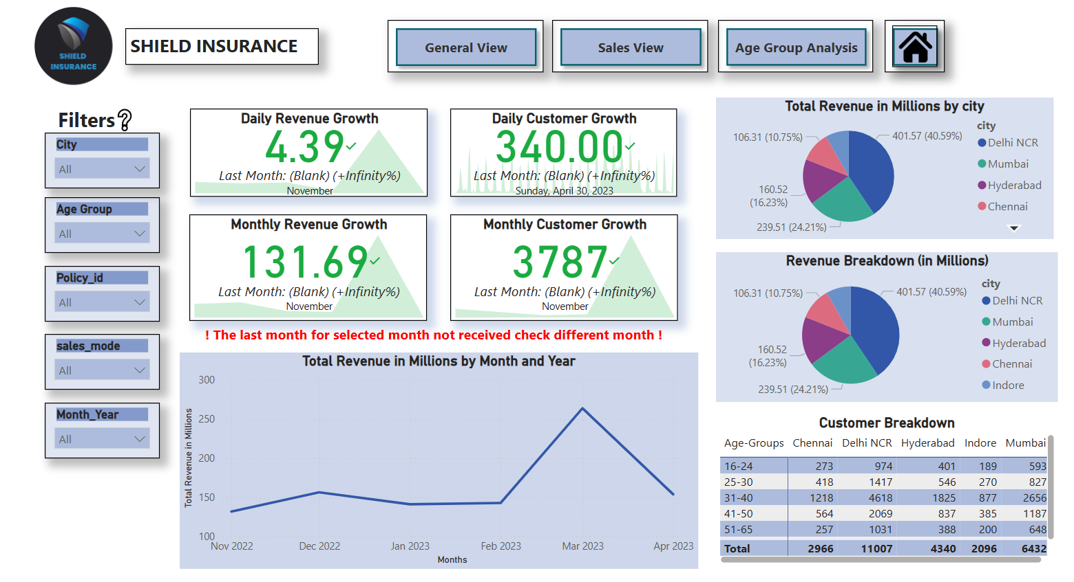
Shield Insurance
07

Slide 8
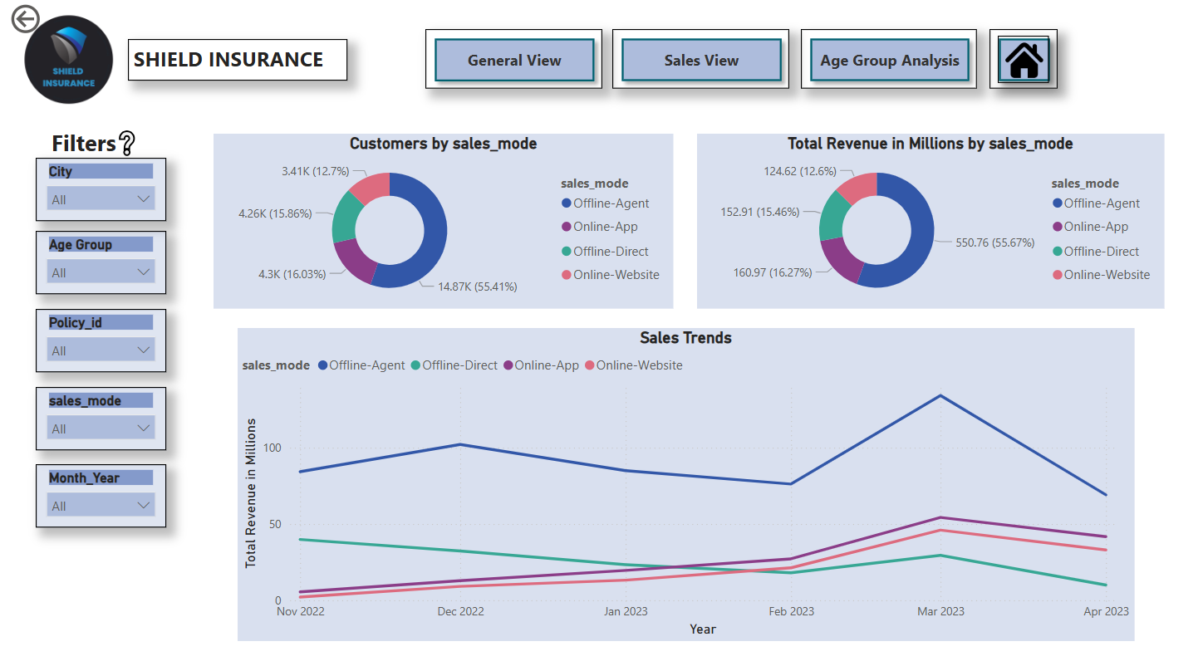
Shield Insurance
08

Slide 9
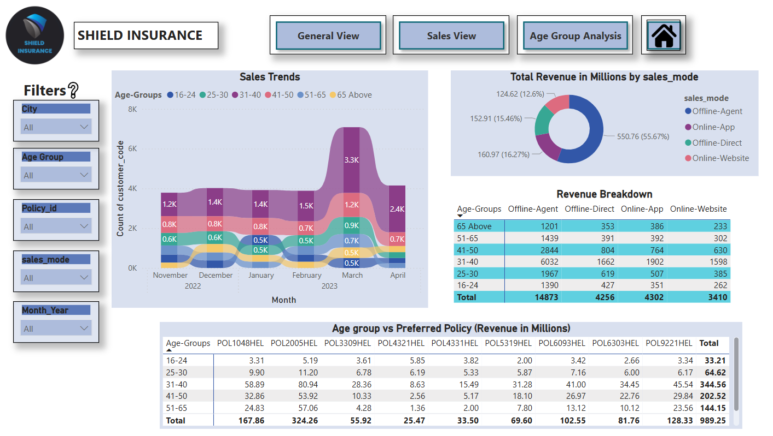
Shield Insurance
09

Slide 10
Shield Insurance
Thank
You
10

